Slide 1

DriverPass System Analysis
Pedro Martinez
Notes:
[No speaker notes required for this slide.]

Slide 2

System Requirements
Functional Requirement
User Account Management
Lesson Scheduling
Nonfunctional Requirement
Performance
Security
Notes:
Hello so we will be talking about the functional and nonfunctional requirements. For the functional we will talk about User Account Management. So its require for us to create, update and even delete account. Its important to to maintain user and experience and securing there data. Lesson Scheduling is to help create schedule or modify. Its important because it helps users book lessons. Now for our nonfunctional we have performance. We should be able to run it with 1000 concurrent users without fail. Its important for it to be running smoothly. Lastly its security its important for the SSL for safeguarding data.

Slide 3
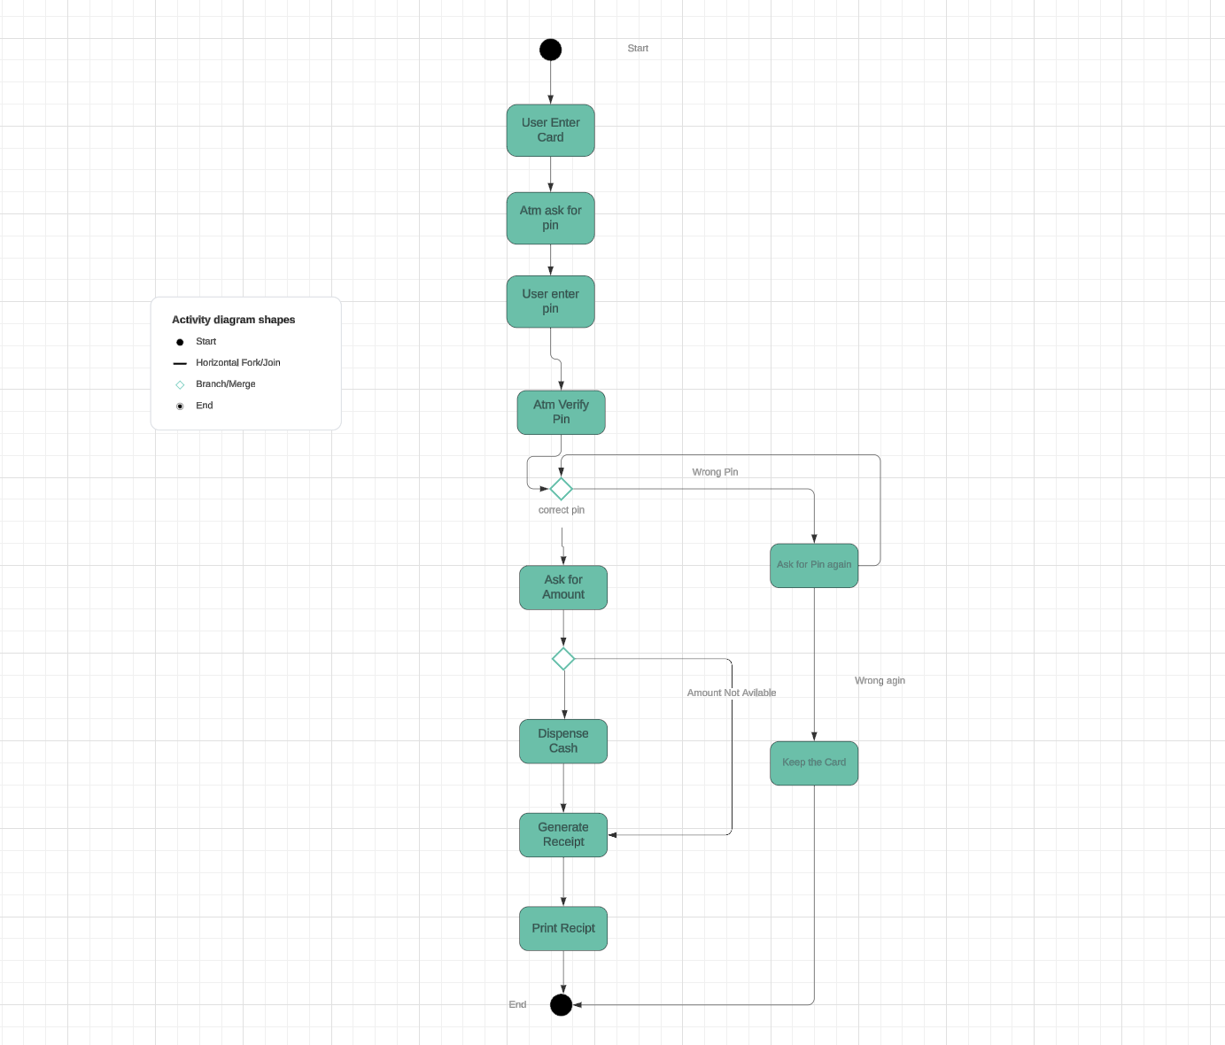
Use Case Diagram
Notes:
The different user are the student and the instructors,admin and the dmv. Some of the Key features are user registration and account management. Lesson scheduling and progress tracking to name a few. It meets the driverpass needs because its easy to use, its safe for security and it has high performance.

Slide 4
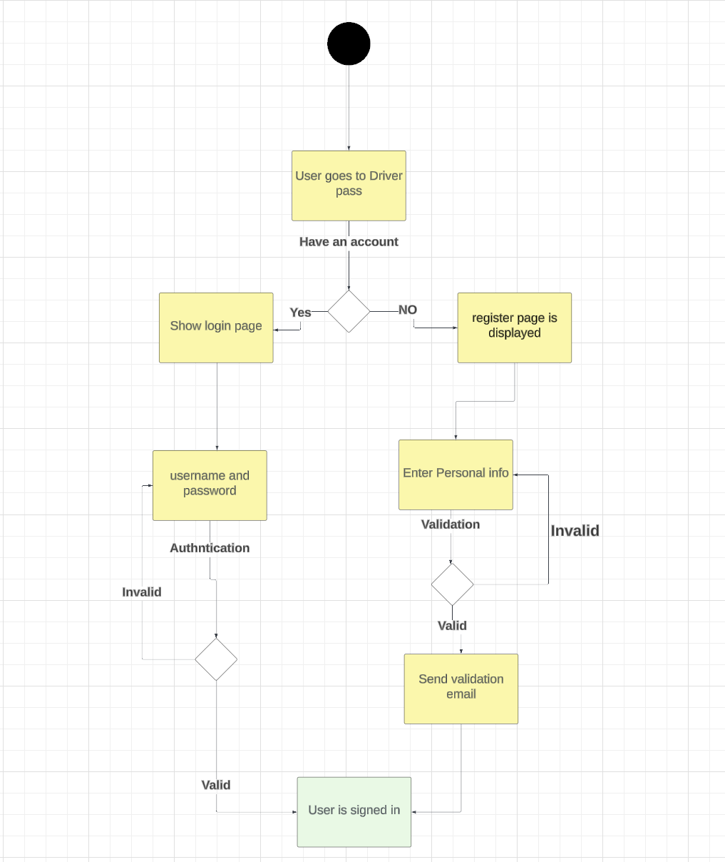
Activity Diagram
Notes:
The user visits the Driverpass Website then starts naviated the driverpass website. It has an Account check that has a yes or no system in place to validate the process. It also has the same process as the login. The email validation is in place to make sure it’s a real account. Its meetings Driverpass needs because it is user friendly, is efficient, and has good security.

Slide 5
Security
Verification factor
Email Verification
Address Verification
Notes:
I kept it in mind but having a verification system in place. I also made sure that the address input is correct before proceeding further. That’s how I kept the security system in mind.

Slide 6
System Limitations
User error
Email heavy
Complex for new users
Notes:
So the limitation are if you don’t have an email that will be a problem. Its an easy fix you can make one off google pretty fast. If the information is typed up wrong the system wont catch it. It could be complex for users who istn tech savy.

